Slide 1
Exploratory data analysis real estate pricing
Name : Rutuja Gawas
Organization Name: NextHikes IT Solutions
Project Name:
Exploratory Data Analysis (EDA) for Real Estate Pricing

Slide 2
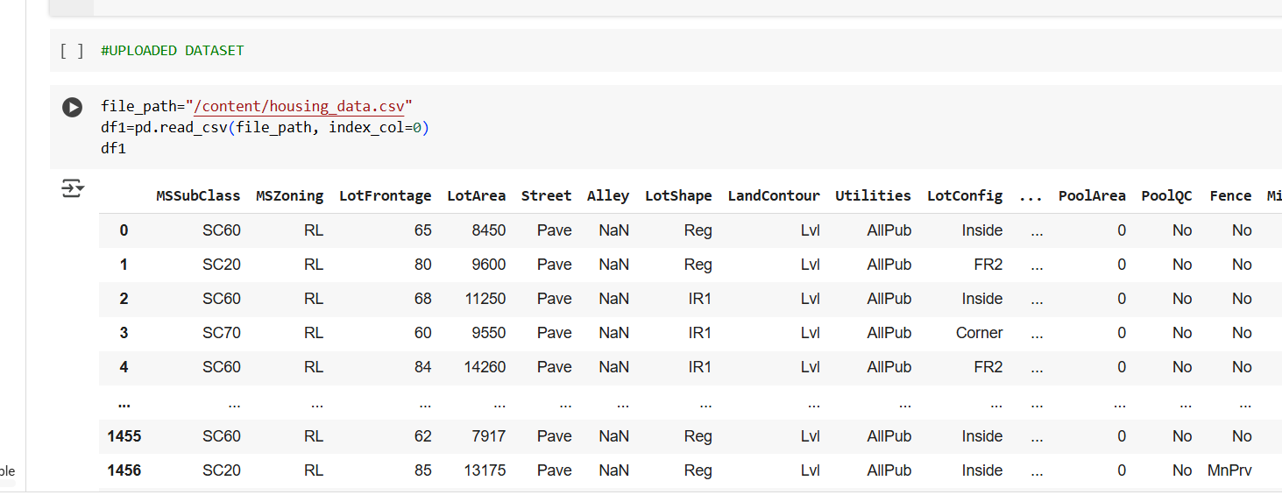
#UPLOADED DATASET

Slide 3
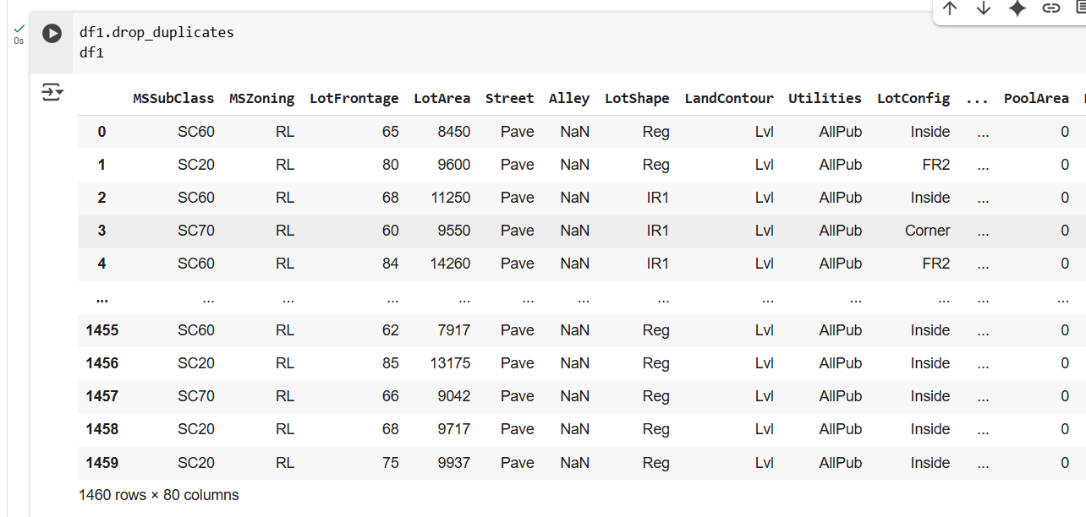
#CLEANING DATA

Slide 4
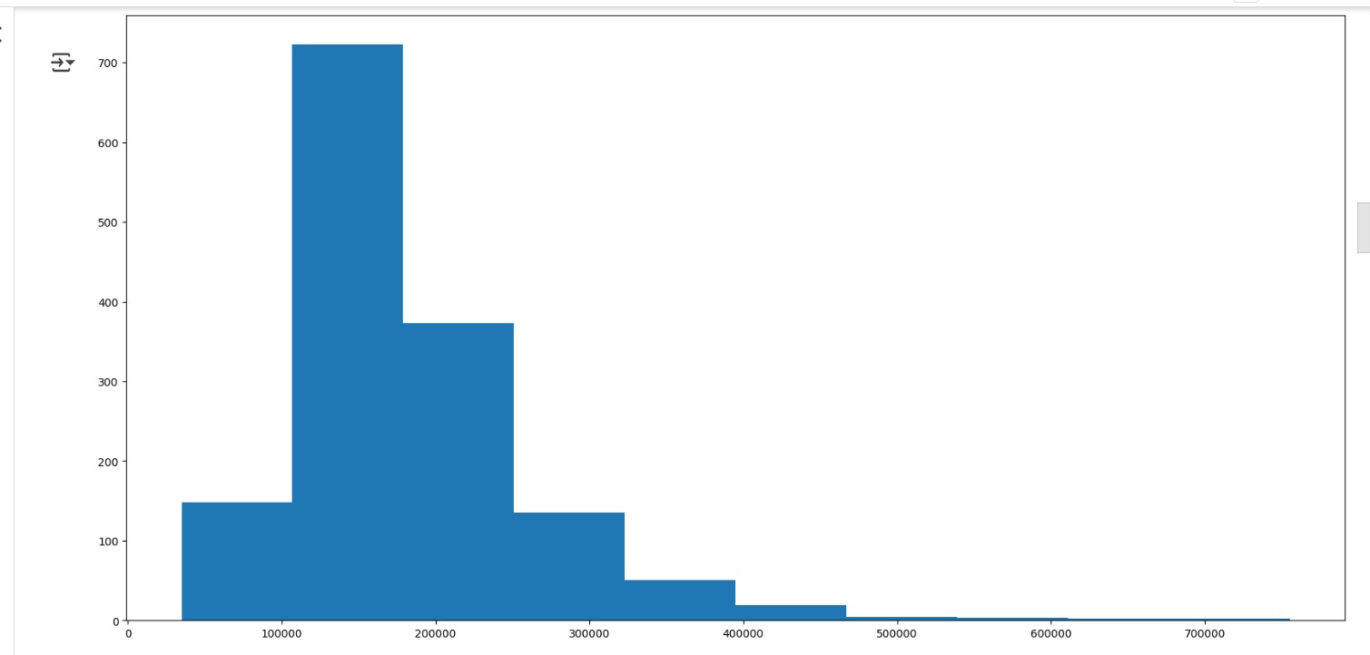
#Univariate Analysis #SALES PRICE FOR HOUSE
Utilize Histogram for Sales price of house
Between 100000 to 200000 more house are sold

Slide 5
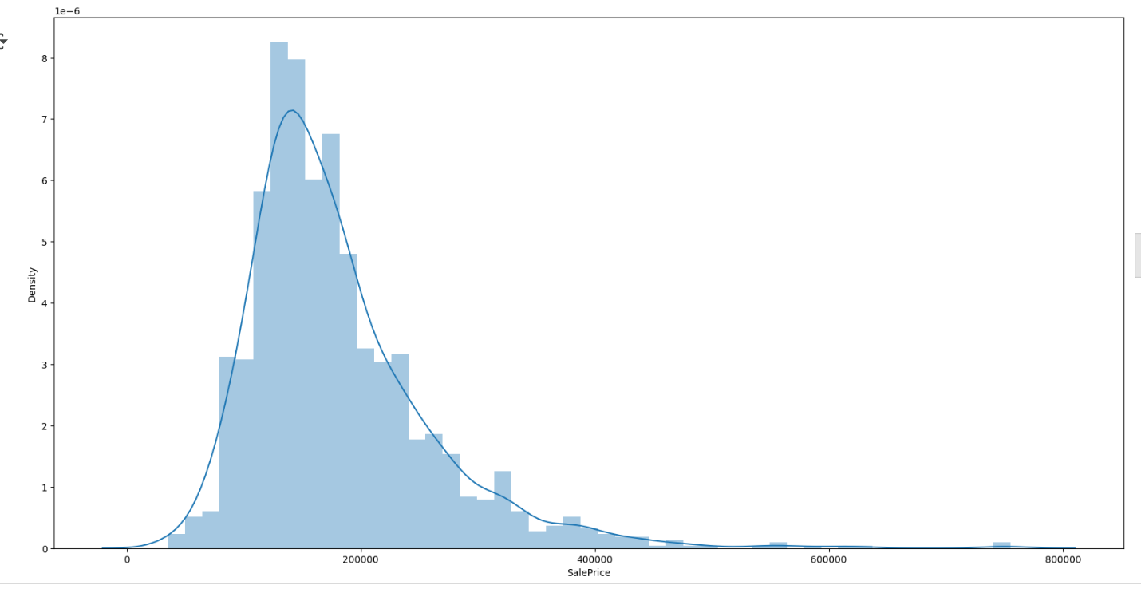
#KERNAL DENSITY ANALYSIS

Slide 6
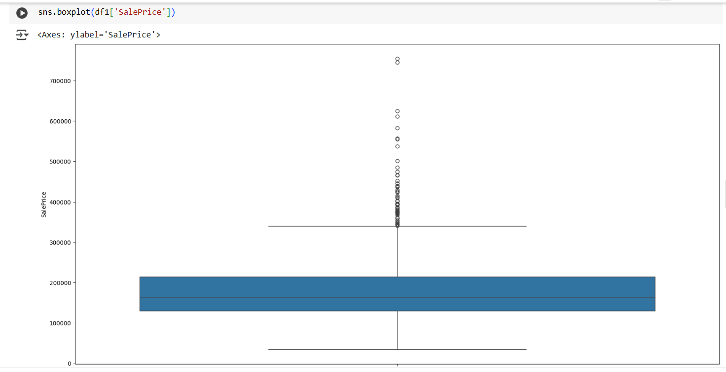
#BOXPLOT
Utilize Histogram for Sales price of house
Between 100000 to 200000 more house are sold
There are some Outliers showing sales price above 700000

Slide 7
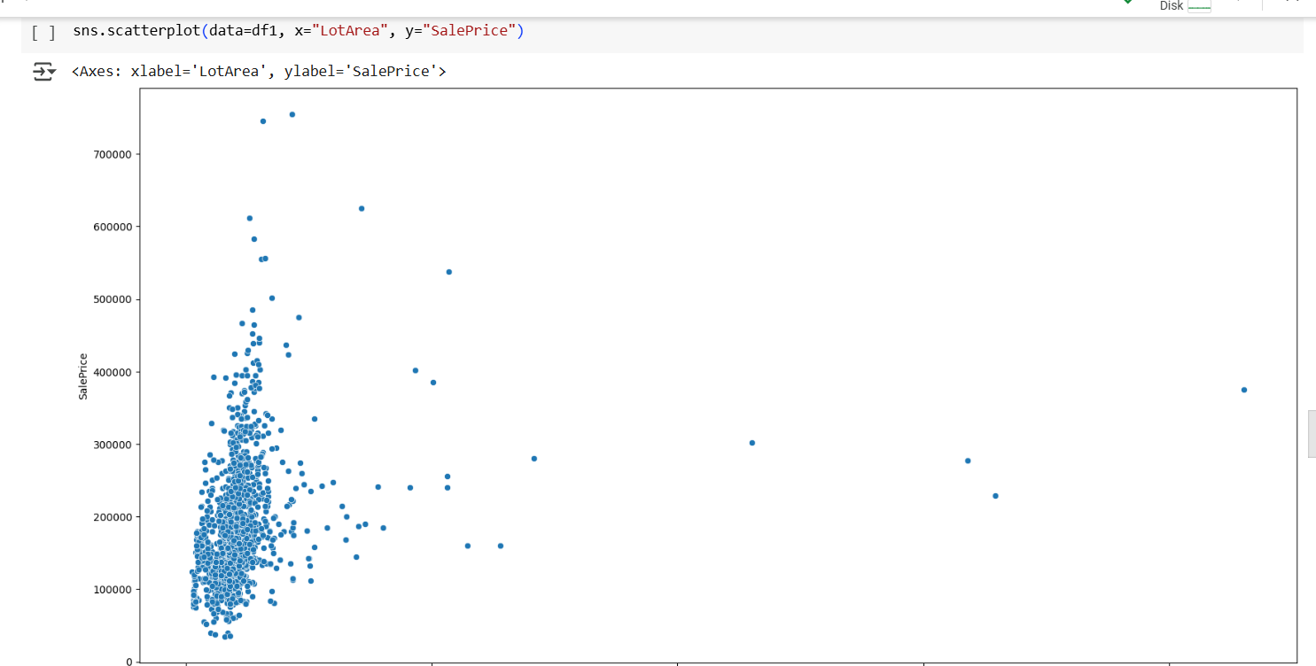

Slide 8
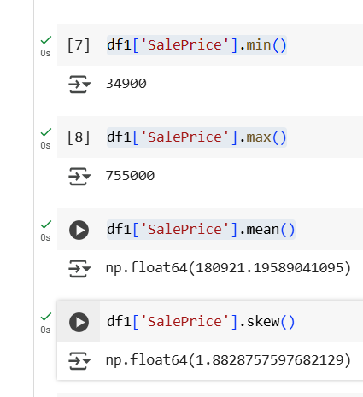
#Skewness of DATA
Minimum & Maximum Sales Price are Outliers
Data is Skew towards Right side

Slide 9
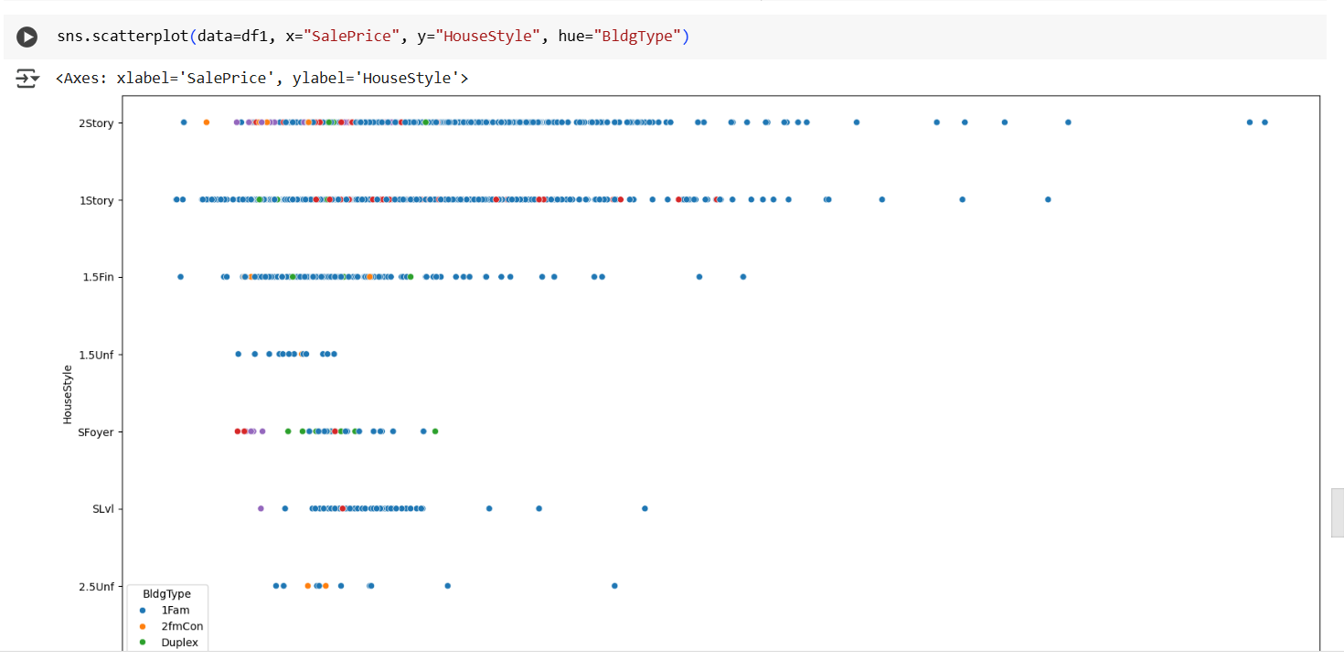
SCATTERPLOT#MULTICOLUMN

Slide 10
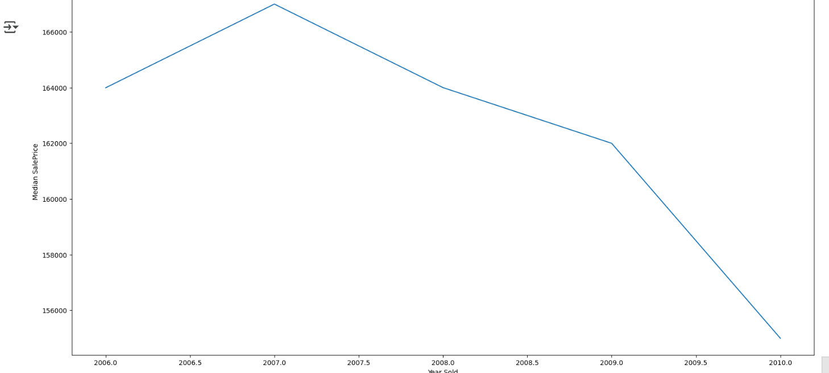
Relation between year the house sold and Sales price using median value

Slide 11

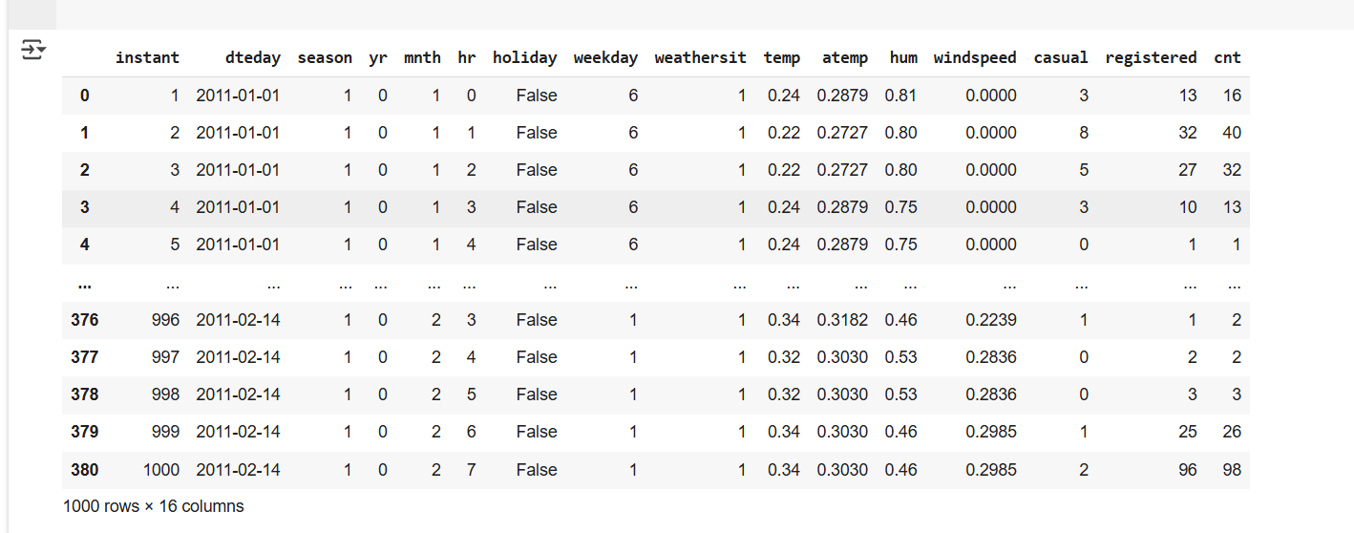
data_season=data_season.sort_values(by='instant')

